Slide 1


Slide 2
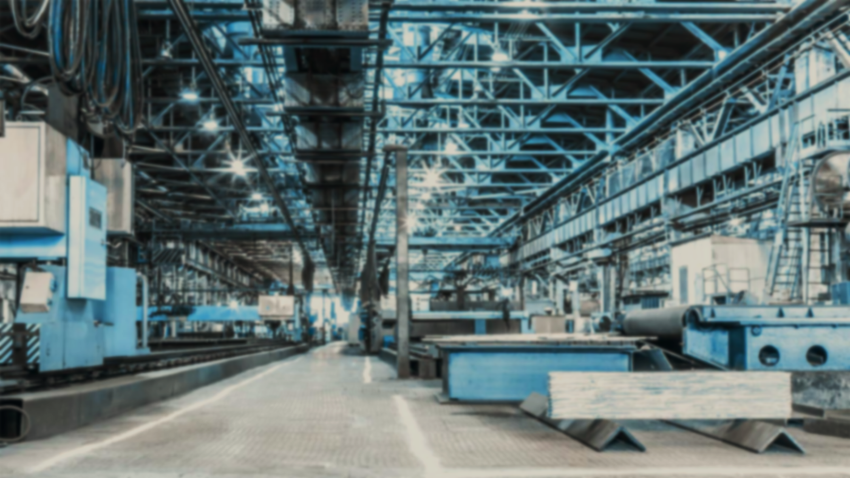











What Is Industrialization?
Origins of Industrialisation
Discuss the overall impact of industrialization
Examples of Industrialization
Group members:
Fahamida Akter_1807
Ahalun Meghobati_1826
Abrarul Hasan_1837
Positive and negative effects of industrialization?
How does Industrialization
impact society?
Environmental Impacts of Industrialization

Slide 3
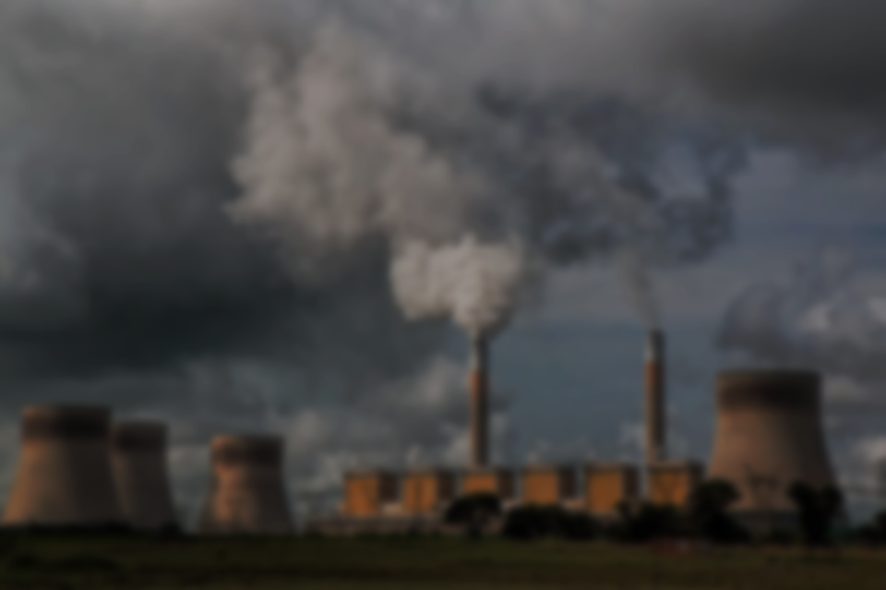
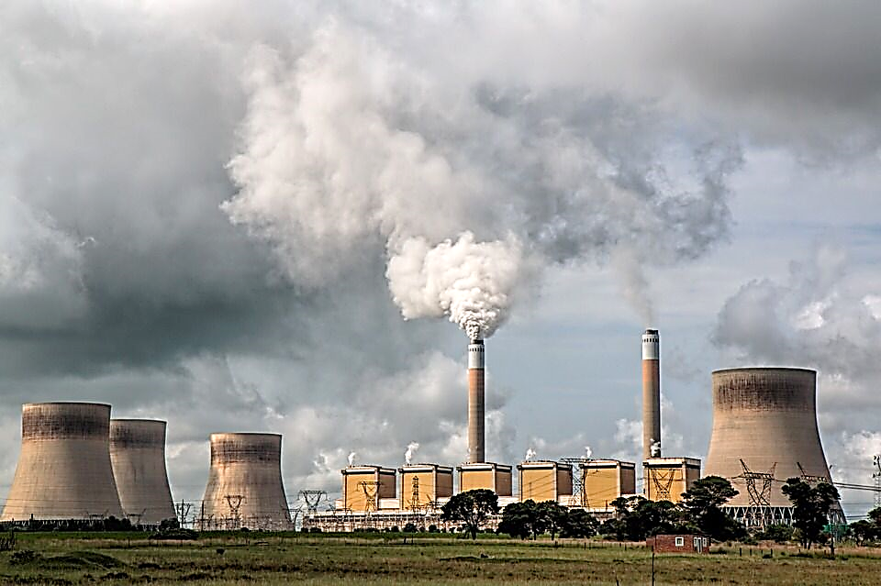
1
What Is Industrialization?
Industrialization is the process in which an economy moves from agriculturally-based to mainly manufacturing.
This process gradually leads to a class of workers with some buying power who demand products, thus stimulating further production.
This lesson will look at the transformation to industrialization and its spread.

Slide 4
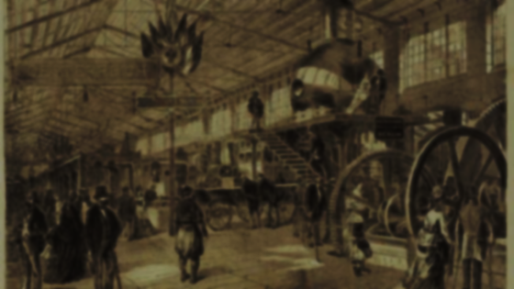
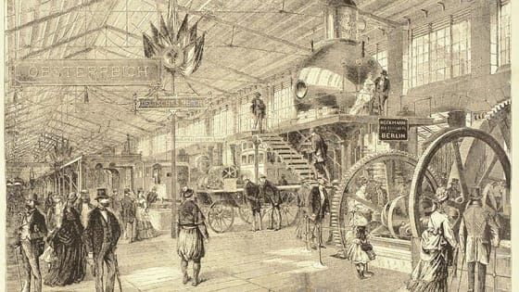
2
Origins of Industrialisation
The innovations of the 19th century allowed for the mass production of commercial goods.
As manufacturing activities grew, transportation, finance, and communications industries all expanded to support the new production capacity.
It also led to increased labor specialization and allowed cities to support larger populations, motivating a rapid demographic shift. People left rural areas in large numbers, seeking jobs in budding industries.

Slide 5


3
Examples of Industrialization
Industrialization is dependent on growth and innovation in at least four industries.
One of the first examples of industrialization was the rise of textile factories in Britain during the 18th and 19th centuries.
Previously, cloth and textiles were woven by hand, mainly in villages across the country.

Slide 6
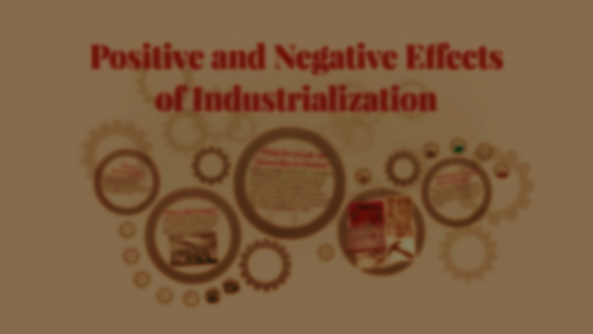
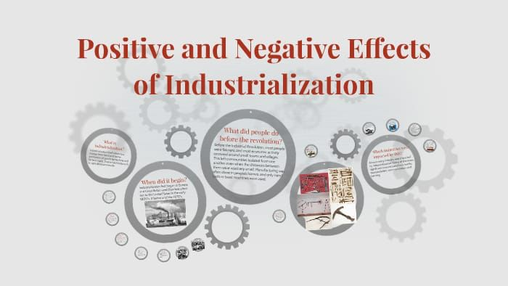
4
Positive and negative effects of industrialization?
The positive effects of industrialization are that it enabled efficient production of much-needed goods like clothing and connected the world through rapid transportation methods.
However, industrialization also harmed the lives of millions of factory workers who became a new working-class and harmed the colonies of European countries which were exploited for their labor and resources.

Slide 7
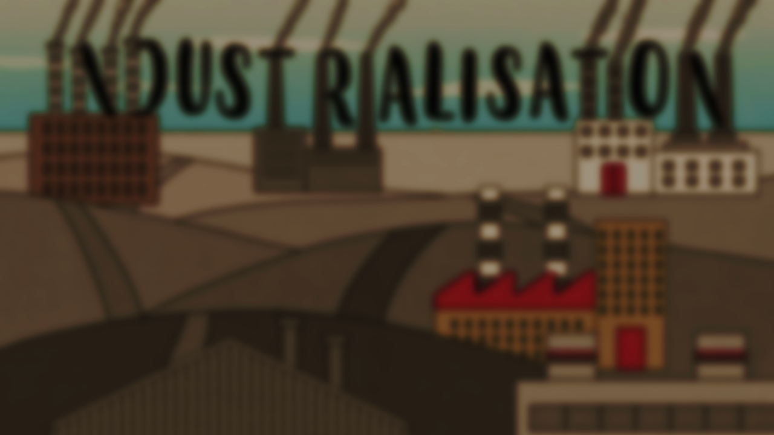
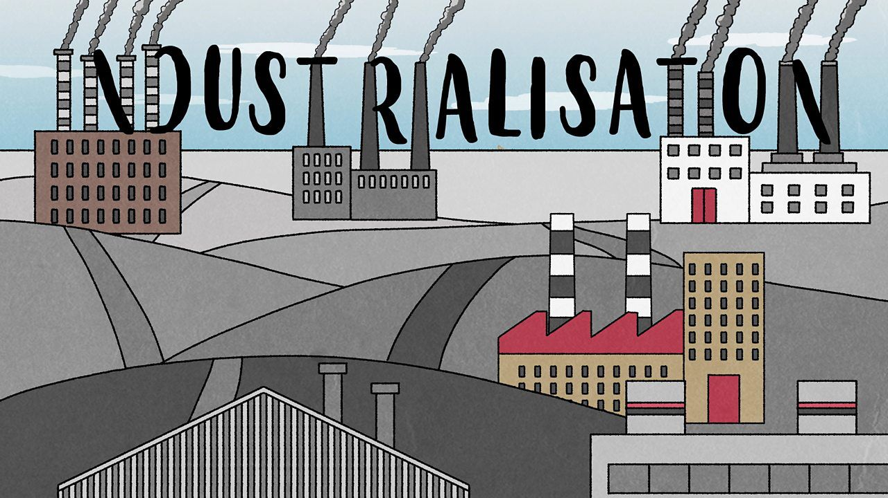
5
How does Industrialization
impact society?
Industrialization creates jobs that draw people from farms and villages to cities where manufacturing takes place.
However hard those jobs were, they were often preferable to the precarious existence of a small farming family.
The result is a new generation of urban consumers. Businesses of all kinds spring up to provide goods and services to these consumers. Over time, a larger middle class of artisans and shopkeepers emerges.

Slide 8
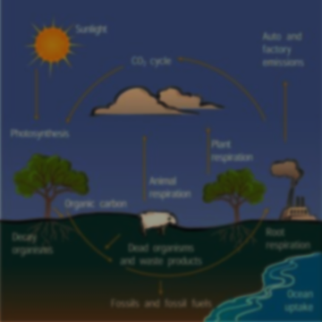
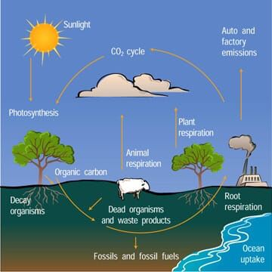
6
Environmental Impacts of Industrialization
The impact of industrialization on the environment has led the way with certain positive and large negative outcomes, with progressive rates and inventions.
There are quite a number of resourceful natural elements like, water, air, soil and fisheries, which are considered to be positive and fertile assets. The pollution of water, soil and air, are defined as the by-product of economical development in industry and city life.
Global warming and greenhouse effects are the result, which is a massive impact of industrialization on the environment.

Slide 9
THANK YOU
CHATTAGRAM

